Slide 1
POLITICAL OPINION MINING FOR POPULARITY PREDICTION
AKSHAYKUMAR M R
03
HYDERALI K

Slide 2
TABLE OF CONTENTS
CONTENT | PAGE
Description About Project | 3
Methodology | 4
Modules | 7
Developing Environment | 8
Product Backlog | 9
User Story | 10
Project Plan | 11
Sprint plans | 12
Sprint 1 | 13

Slide 3
POLITICAL OPINION MINING FOR POPULARITY PREDICTION
This research proposes an approach that is based on Twitter based Political opinion mining for predicting the popularity of a person on a given set of Tweets containing varied opinion. The objective is to extract expressions of opinion and predict the personality of political member by classifying them as positive or negative; also this system is going to encounter Hinglish language which is mash up of Hindi and English language. This approach applies deep learning techniques to the task of sentiment analysis and opinion mining. In order to this recurrent neural network (RNN) is used. In this research Long ShortTerm Memory Units are used and a full Tensorflow based Opinion and Sentiment classifier is made at the end. This approach is going to use the concept of Sentiment Analysis i.e. tracking opinion of public, which uses the natural language processing and extract the information like either public’s view is positive or negative which can be used further to predict popularity of political arty member. The data that is to be taken here is from twitter tweets.

Slide 4
METHODOLOGY
Step 1: Data collection and dataset preparation
This will involve collection of the data from Twitter and Politics and political attitude dataset is used. Tweepy - (API) is used to collect the data from twitter. Then, preprocessing is done on the dataset and features are extracted from the data. Also the data is divided into 2 parts testing data and training data.
Step 2: Developing ARNN (LSTM) based Model for Political Opinion Mining For Popularity Prediction
In this step a RNN model with LSTM integrated is designed for performing the political opinion mining and predicting the popularity. Different hyper parameters are tuned for this model. This model will classify the opinions into 2 categories that is positive and negative opinion and then popularity of that political party member is predicted according to the classified opinion of public from Twitter.
Step 3: Training and experimentation on datasets
The RNN based model that consist LSTM for
political opinion mining for popularity prediction will be trained on the training dataset to do Opinion Mining accurately and notify.
Step 4: Deployment and analysis on real life scenario

Slide 5
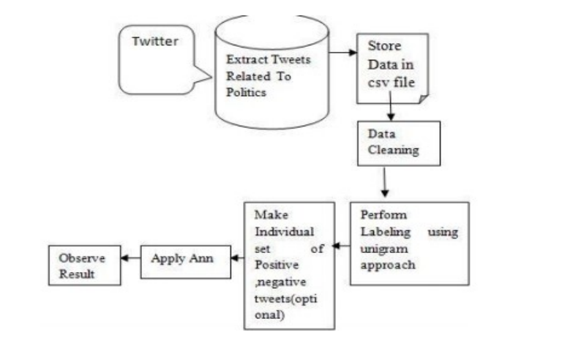
Basic Methodology of Opinion Mining

Slide 6
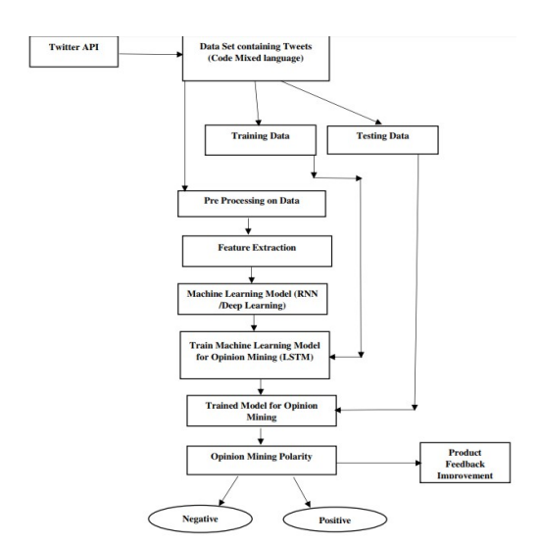
Flow Chart of political Opinion Mining for Popularity Prediction.
The trained and tested popularity prediction based on political opinion mining model will be deployed in a real-life scenario to
get the opinion of public and predict the popularity of political party member & will be leveraged for further improvement in
the methodology and will follow the above architecture.

Slide 7
MODULES
Module 1:-Data Set Creation and Data Preprocessing
Here, we are creating dataset from existing data.
Pre-processing data: converting the data into a well-defined form by null value elimination and clerical mistake correction.
Module 2:-Create User Interface
This module includes creation of user register and login, data collection form and result printing form.
Module 3:-Training the data
Here we train the data set using RNN with LSTM
And generate the model file and store.
Module 4:-Testing the data
Collect new user data.
Predict the result using trained data.
Print the result to user.

Slide 8
DEVELOPING ENVIRONMENT
Hardware Requirements:
Processor: i3
Hard Disk: 500 GB
RAM: 4 GB
Software Requirements:
Language: Python
Front End: Python-django
Back end: SQlite
Dataset: US Election Dataset from Kaggle Website.
Algorithm: RNN with LSTM
IDE: Visual Studio Code, Anaconda Navigator
OS: Windows

Slide 9
PRODUCT BACKLOG
User story ID | Priority <High/Medium/Low> | Size (Hours) | Sprint <#> | Status <Planned/In progress/Completed> | Release Date | Release Goal
1 | Medium | 2 | 1 | Completed | 27/12/2021 | Collection of US election datasets
2 | Medium | 3 |  | Completed | 28/12/2021 | Modelling the datasets
3 | Medium | 5 | 2 | planned | 29/12/2021 | UI design
4 | Medium | 5 |  | Planned | 15/01/2022 | User Registration,,Login Form
5 | Medium | 5 |  | planned | 16/01/2022 | View prediction
6 | Medium | 5 |  | Planned | 22/01/2022 | View prediction Accuracy
7 | High | 10 | 3 | Planned | 23/01/2022 | Train the model using dataset (RNN)
8 | Medium | 4 | 4 | Planned | 26/01/2022 | Testing
9 | Medium | 4 |  | Planned | 29/01/2022 | Input new dataset
10 | Medium | 4 |  | Planned | 05/02/2022 | Generate Result
11 | Medium | 3 |  | Planned | 12/02/2022 | Print Accuracy

Slide 10
USER STORY
User Story ID | As a type of User | I want to <perform some task> | So that I can < Achieve Some Goal>
1 | User | Collection of datasets | US election datasets
2 | User | Modelling the datasets | Modelling the datasets
3 | User | UI design | User Interface
4 | User | User Registration,Login Form | Login and Registration
5 | User | View prediction | View prediction
6 | User | View prediction Accuracy | View prediction Accuracy
7 | User | Train the model using dataset (RNN with LSTM) | 70% -training data
8 | User | Testing | 30%-testing data
9 | User | Input new dataset | Tested data & input from user
10 | User | Generate Result | Generate Result
11 | User | Print Accuracy | Print Accuracy

Slide 11
PROJECT PLAN
User Story ID | Task Name | Start Date | End Date | Days | Status
1 | Sprint 1 | 27/12/2021 | 27/12/2021 | 2 | Completed
2 |  | 28/12/2021 | 28/12/2021 |  | Completed
3 | Sprint 2 | 29/12/2021 | 17/01/2022 | 5 | Planned
4 |  | 17/01/2022 | 19/01/2022 |  | Planned
5 |  | 19/01/2022 | 21/01/2022 |  | Planned
6 |  | 22/01/2022 | 22/01/2022 |  | Planned
7 | Sprint 3 | 23/01/2022 | 23/01/2022 | 1 | Planned
8 | Sprint 4 | 26/01/2022 | 26/01/2022 | 4 | Planned
9 |  | 29/01/2022 | 29/01/2022 |  | Planned
10 |  | 05/02/2022 | 05/02/2022 |  | Planned
11 |  | 12/02/2022 | 12/02/2022 |  | Planned

Slide 12
SPRINT PLANS
Backlog Item | Status and Completion date | Original Estimate in hours | Day 1 | Day 2 | Day 3 | Day 4 | Day 5 | Day 6 | Day 7 | Day 8 | Day 9 | Day 10 | Day 11 | Day 12
User story #1,2 |  |  | Hours | hrs | hrs | hrs | hrs | hrs | hrs | hrs | hrs | hrs | hrs | hrs
Dataset Collection | 27/12/21 | 2 | 2 | 0 | 0 | 0 | 0 | 0 | 0 | 0 | 0 | 0 | 0 | 0
Analysis | 28/12/21 | 3 | 0 | 3 | 0 | 0 | 0 | 0 | 0 | 0 | 0 | 0 | 0 | 0
User story #3,4,5,6
UI Designing | 19/01/22 | 10 | 0 | 0 | 4 | 4 | 3 | 0 | 0 | 0 | 0 | 0 | 0 | 0
Coding | 22/01/22 | 10 | 0 | 0 | 0 | 0 | 0 | 5 | 5 | 0 | 0 | 0 | 0 | 0
User story #7
Training | 23/01/22 | 10 | 0 | 0 | 0 | 0 | 0 | 0 | 0 | 5 | 5 | 0 | 0 | 0
User story #8,9,10,11
Testing | 12/02/22 | 15 | 0 | 0 | 0 | 0 | 0 | 0 | 0 | 0 | 0 | 5. | 5 | 5
Total |  | 50 | 2 | 3 | 4 | 4 | 3 | 5 | 5 | 5 | 5 | 5 | 5 | 5

Slide 13
SPRINT 1
Backlog Item | Status and Completion date | Original Estimate in hours | Day 1 | Day 2 | Day 3 | Day 4 | Day 5 | Day 6 | Day 7 | Day 8 | Day 9 | Day 10 | Day 11 | Day 12 | Completed <Y/N>
User story #1,2 |  |  | Hours | hrs | hrs | hrs | hrs | hrs | hrs | hrs | hrs | hrs | hrs | hrs
Dataset Collection | 27/12/21 | 2 | 2 | 0 | 0 | 0 | 0 | 0 | 0 | 0 | 0 | 0 | 0 | 0 | Y
Analysis | 28/12/21 | 3 | 0 | 3 | 0 | 0 | 0 | 0 | 0 | 0 | 0 | 0 | 0 | 0 | Y
User story #3,4,5,6
UI Designing | 19/01/22 | 10 | 0 | 0 | 4 | 3 | 3 | 0 | 0 | 0 | 0 | 0 | 0 | 0 | N
Coding | 22/01/22 | 10 | 0 | 0 | 0 | 0 |  | 5 | 5 | 0 | 0 | 0 | 0 | 0 | N
User story #7
Training | 23/01/22 | 10 | 0 | 0 | 0 | 0 | 0 | 0 | 0 | 5 | 5 | 0 | 0 | 0 | N
User story #8,9,10,11
Testing | 12/02/22 | 15 | 0 | 0 | 0 | 0 | 0 | 0 | 0 | 0 | 0 | 5 | 5 | 5 | N
Total |  | 50 | 2 | 3 | 4 | 3 | 3 | 5 | 5 | 5 | 5 | 5 | 5 | 5

Slide 14
Thank You

